Slide 1


21st October 2015
Stillorgan Village Area Movement Framework Plan
PUBLIC CONSULTATION INFORMATION PERIOD DOCUMENT

Slide 2


Area of Movement Framework Plan

Slide 3
Purpose of Movement Framework Plan
To provide improvements to the Public Realm, which when combined with inventive planning by private Developers/Businesses will ensure and sustain a rich and vibrant Stillorgan Village.
To develop a place where people living and working in Stillorgan can move around within a network of safe, pleasant and well connected streets, civic spaces, green links and benefit from an improved environment around the village core.
To provide for an increase in walking, cycling and safer access to Public Transport.
The Plan will build on information contained in the Stillorgan Local Area Plan 2007 and in accordance with the objectives of the dlr County Development Plan 2016-2022.

Slide 4
Objectives of the Plan
To advance measures/initiatives in line with the objectives of Stillorgan Local Area Plan;
To facilitate the future growth and success of Stillorgan Village;
To protect and enhance the role of Stillorgan Village as a District Centre focusing on public realm improvements to create a safe and attractive environment for visitors;
To assess movements around and through the Stillorgan Village Area and optimise accessibility within the village;
Modal shift through improved access to public transport and better connectivity for pedestrians and cyclists;
Pedestrian, cycle, public transport, car and delivery vehicle networks to be designed to maximise connectivity, permeability and ease of movement for soft modes;
To create multi-functional streets that balance ‘movement’ and ‘place’ and safety for all users within a traffic calmed environment;
To improve access to and legibility of short stay car parking.

Slide 5
Barriers to achieving a vibrant village area
Disconnected village sections
Impression of car priority
Inadequate Pedestrian/ Cycle facilities
Extensive parking areas dominate landscape
Poor visual and recreational/leisure amenity
Balance between reduced vehicular lane widths through the village and preventing queuing onto N11

Slide 6
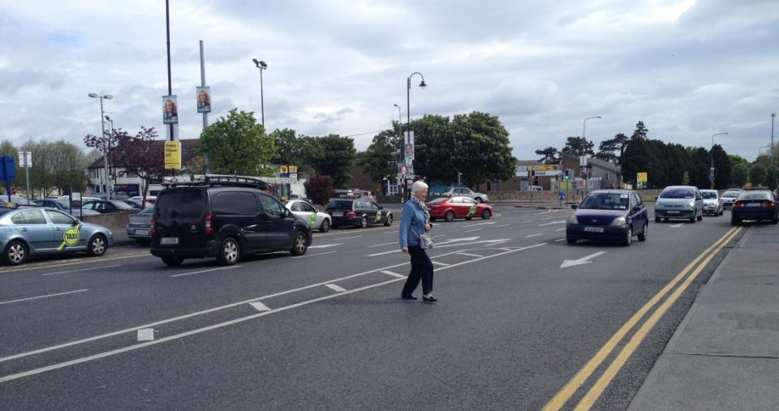
Problem Identification
Inadequate pedestrian facilities, impression of car priority

Slide 7
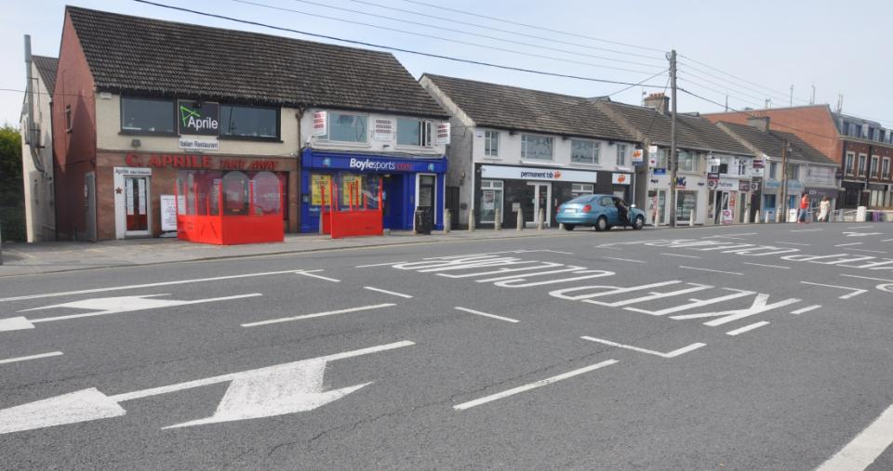
Problem Identification
Poor visual amenity, extensive carriageway width

Slide 8
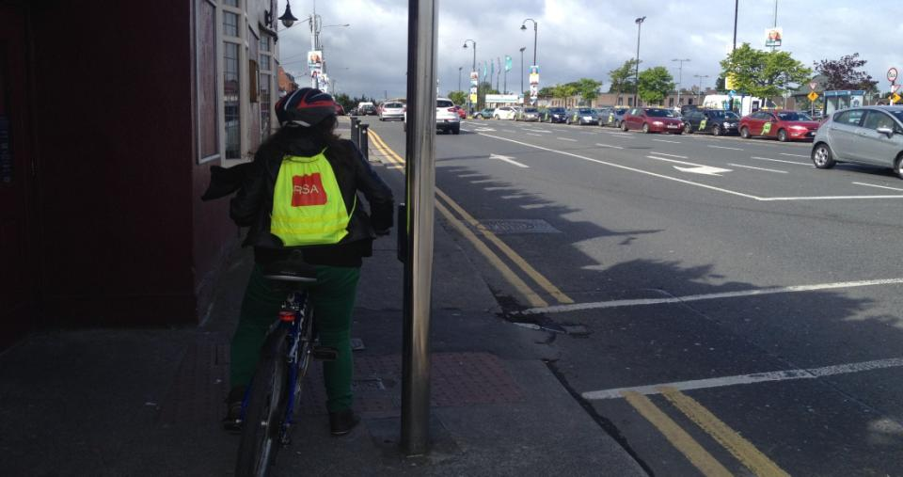
Problem Identification
No cycle facilities, tarmac dominated public realm

Slide 9
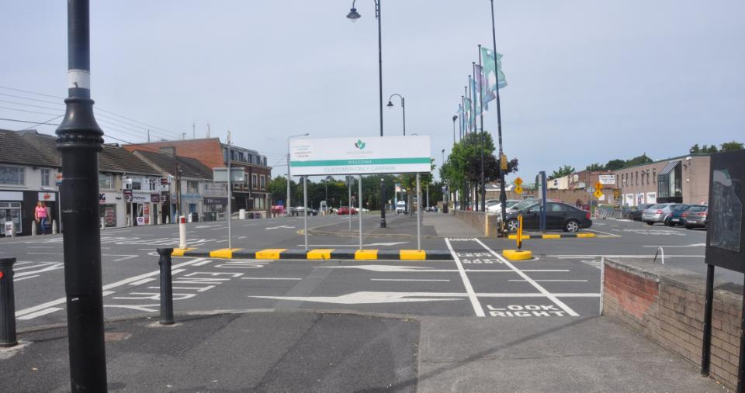
Problem Identification
Potential for public realm improvement

Slide 10
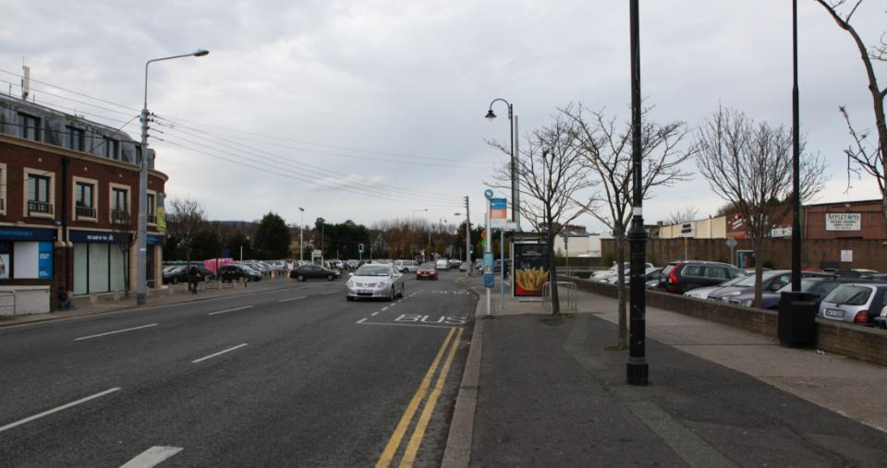
Problem Identification
Potential for improved connectivity

Slide 11
Works undertaken to date
Preliminary consultation with Stillorgan Chamber of Commerce and main local stakeholders.
Identification of existing problems within the Public Realm.
Data Collections in terms of Land Use and Planning Surveys, Traffic Surveys, Parking Surveys, Topographical Surveys and Public Attitude surveys.
Reviewed the issues raised and developed drawings and artist's impressions to show a modern and interesting vision of Stillorgan Village.
Proposals were designed to dove-tail into the existing environment, while allowing for future development within the village core.

Slide 12
Process for the Stillorgan Framework Plan
Public Consultation Information Period with the Stakeholders, residents and visitors of Stillorgan Village.
Consultation period from Wednesday 28th October to Wednesday 9th December 2015.
Purpose of this Consultation Period is to invite submissions from the public and allow interested parties and individuals to view the Council’s proposals and “Have Their Say”.
Submissions and feedback received will help to inform the approach and final layout of the Stillorgan Village Area Movement Plan.
A further Public Consultation Period will be undertaken on the refined completed plan in early/mid 2016.

Slide 13
Future Vision
The Stillorgan Village Area Movement Framework Plan
will form a Master Plan.
Following the adoption of this Master Plan individual schemes/projects can be developed and constructed over a phased basis.
These schemes/projects will be delivered by working in conjunction with local Businesses in a spirit of partnership and supported by local Residents and Elected Members.

Slide 14
Overall Plan – Existing Layout

Slide 15
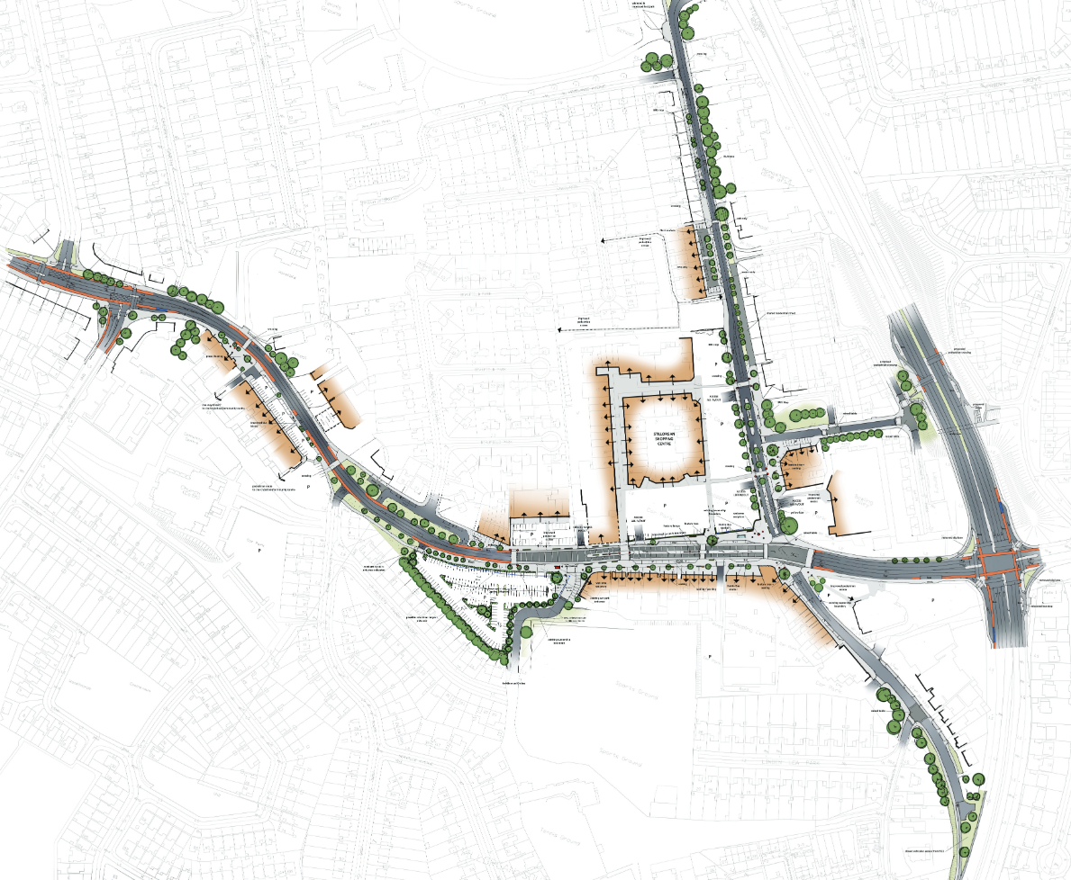
Overall Plan - Emerging Preferred Options

Slide 16
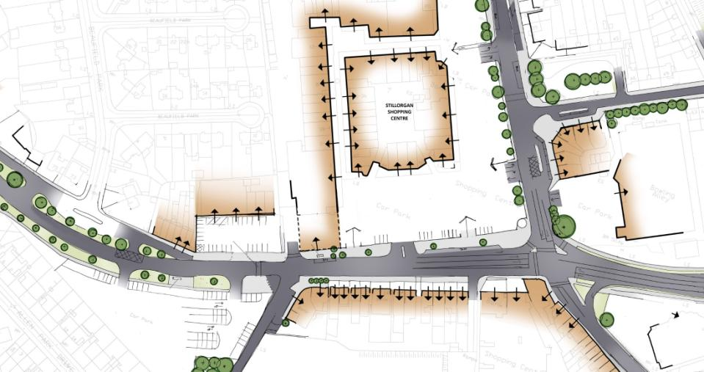

Existing Plan Layout
Existing Village Core

Slide 17
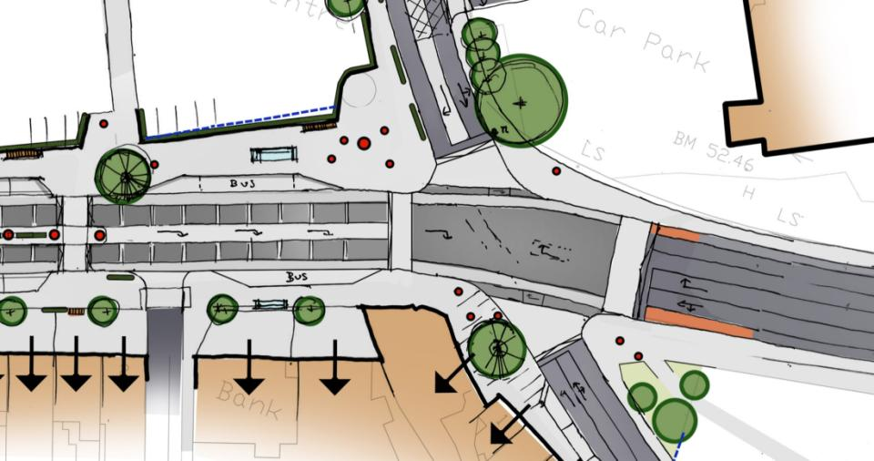
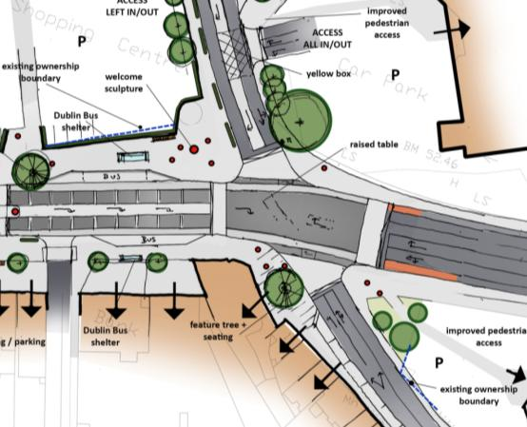
Old Dublin Road/ Lower Kilmacud Road Junction
Emerging Preferred Option

Slide 18
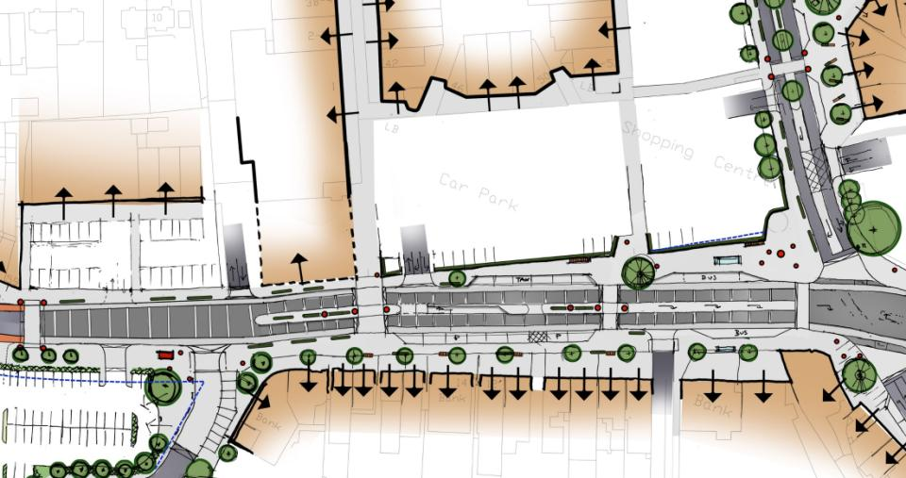
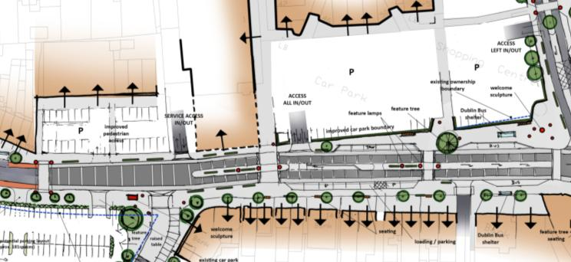

Car Park Accesses
Emerging Preferred Option

Slide 19
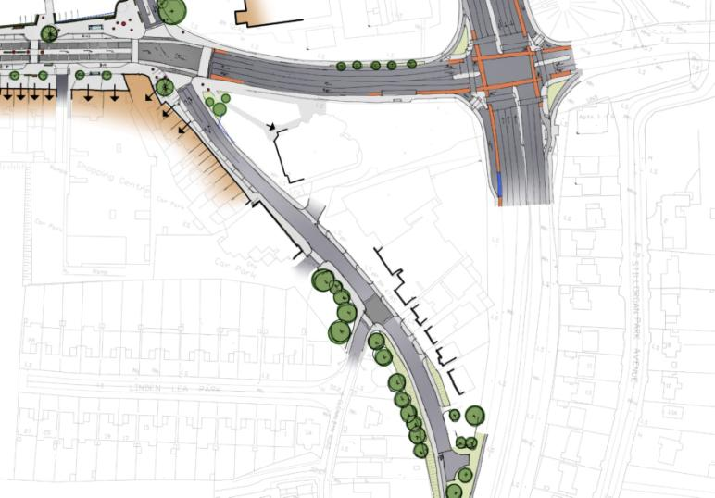
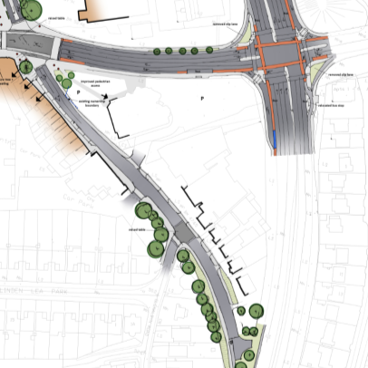
N11/Lr. Kilmacud Rd Junct & The Hill/ N11 Slip
Emerging Preferred Option

Slide 20
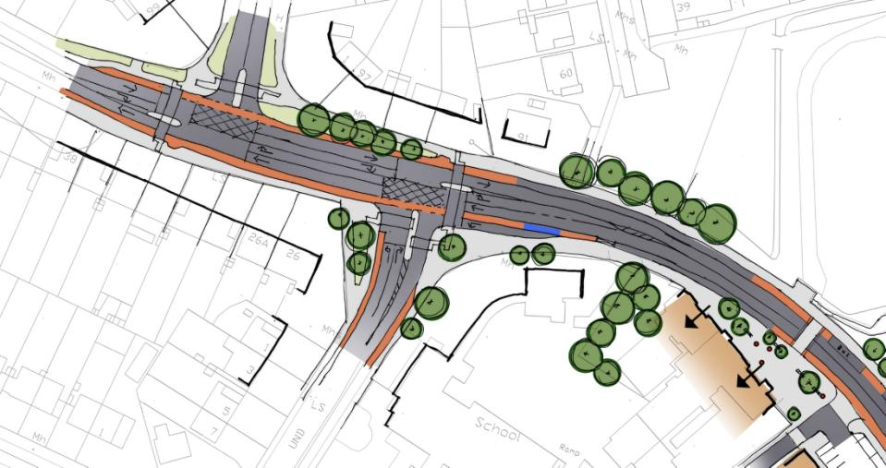
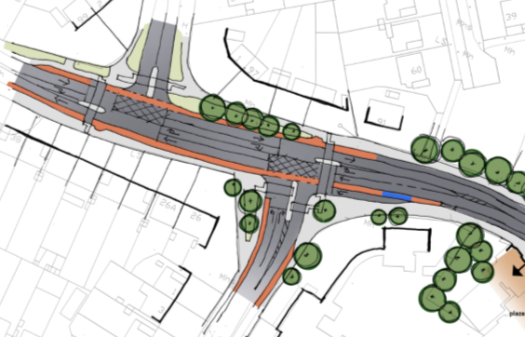
Upper/ Lower Kilmacud Road & South Avenue
Emerging Preferred Option

Slide 21
Connection to Public Transport Links
Emerging Preferred Option

Slide 22
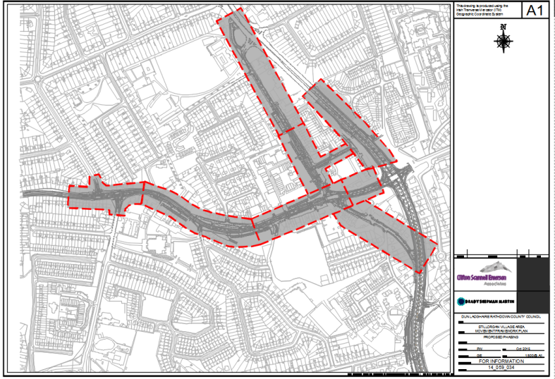
Possible Phases of Work

Slide 23
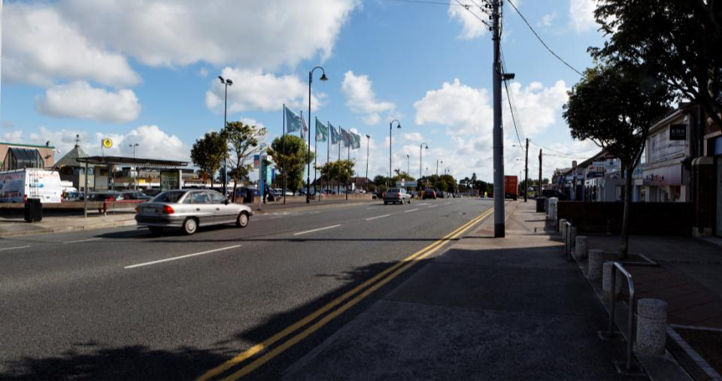
Existing Streetscape
Lower Kilmacud Road Currently (looking East)

Slide 24
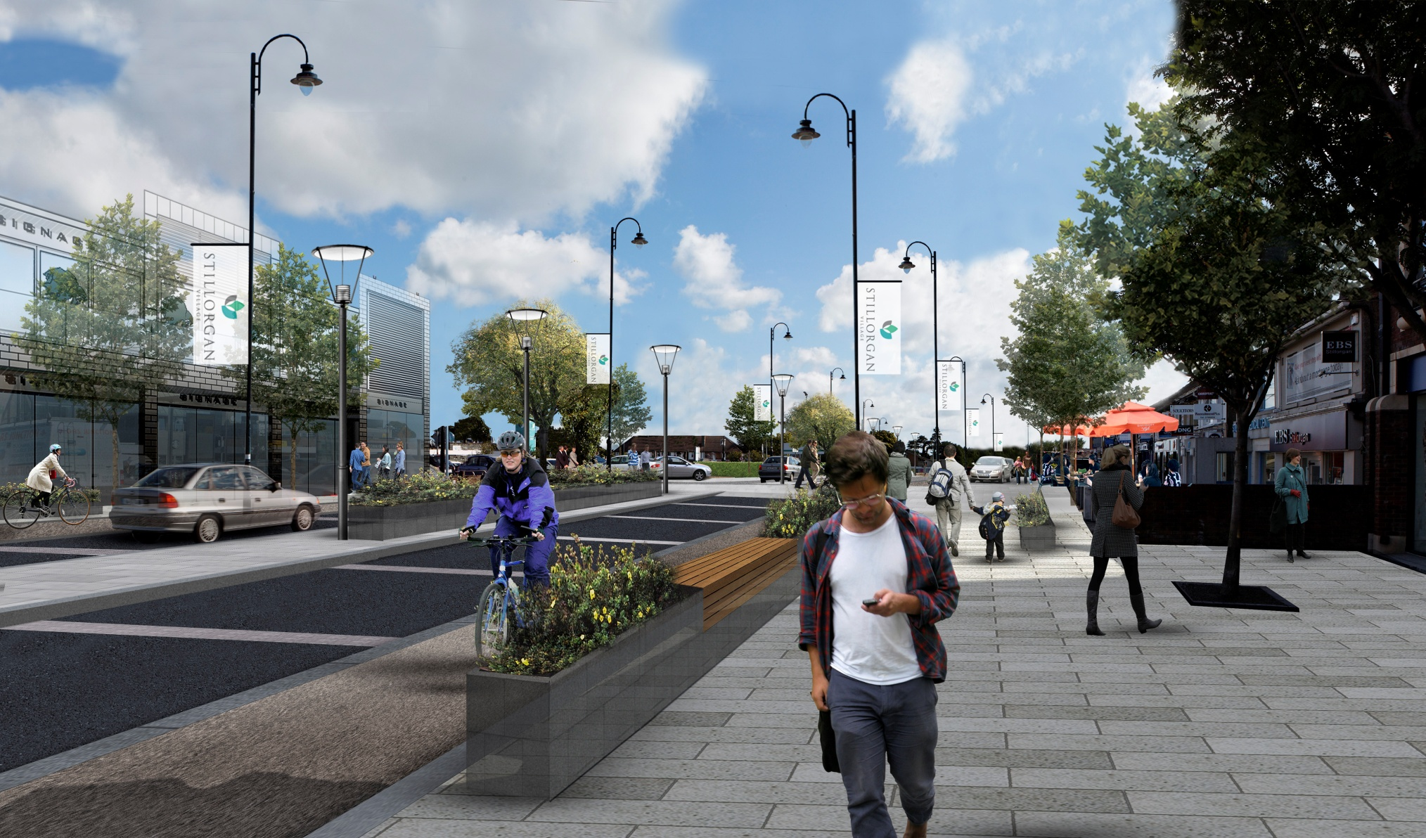
Emerging Artist’s Impression
Lower Kilmacud Road Potential (looking East)

Slide 25
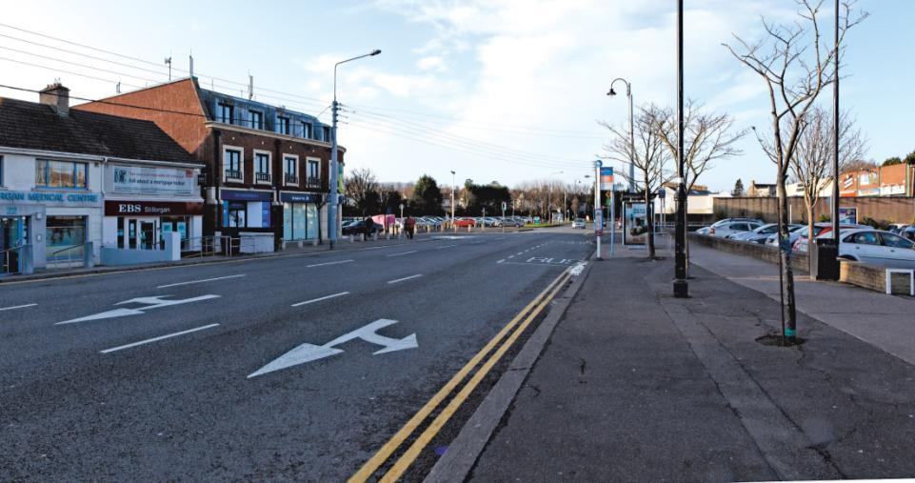
Existing Streetscape
Lower Kilmacud Road Currently (looking West)

Slide 26
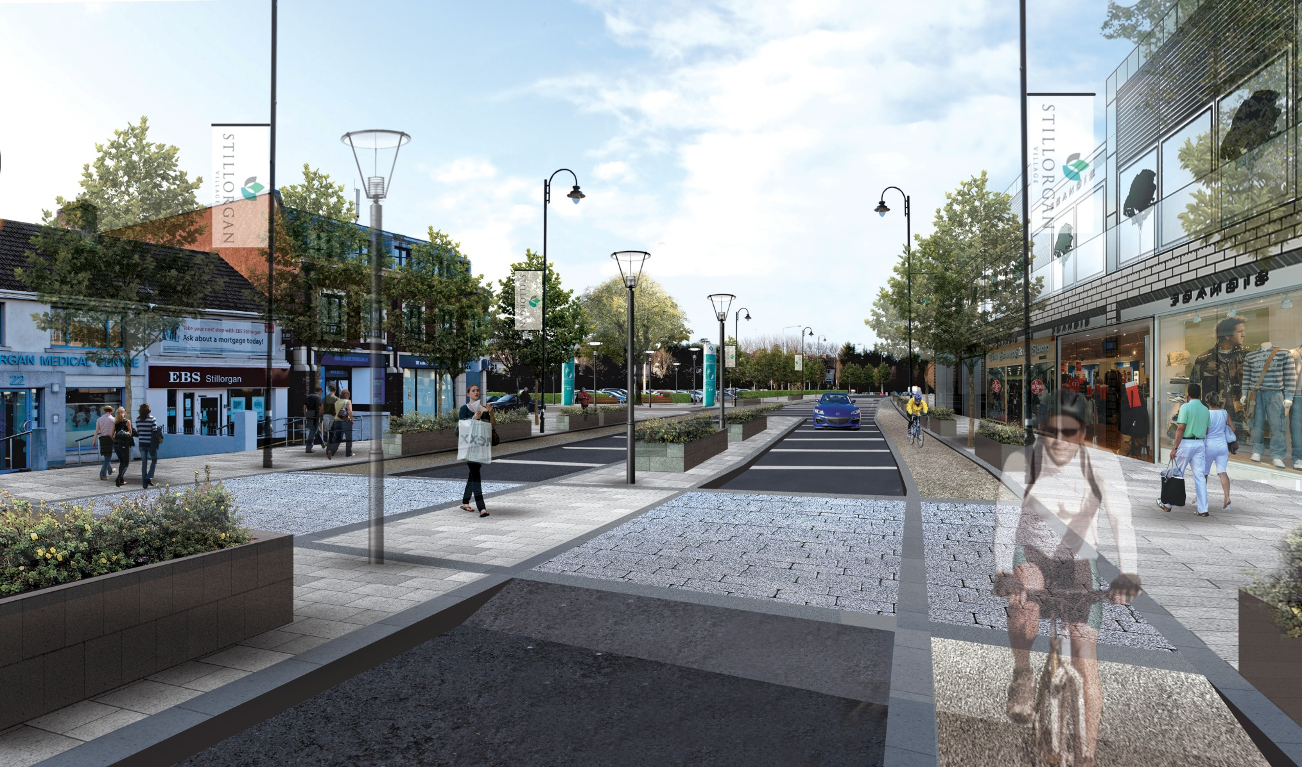
Emerging Artist’s Impression
Lower Kilmacud Road Potential (looking West)

Slide 27
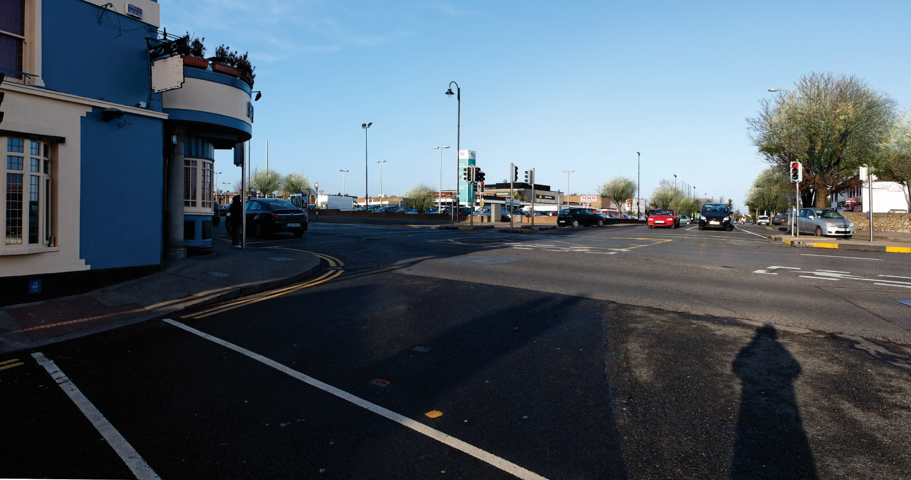
Existing Streetscape
Lower Kilmacud Rd / The Hill Junction Currently

Slide 28
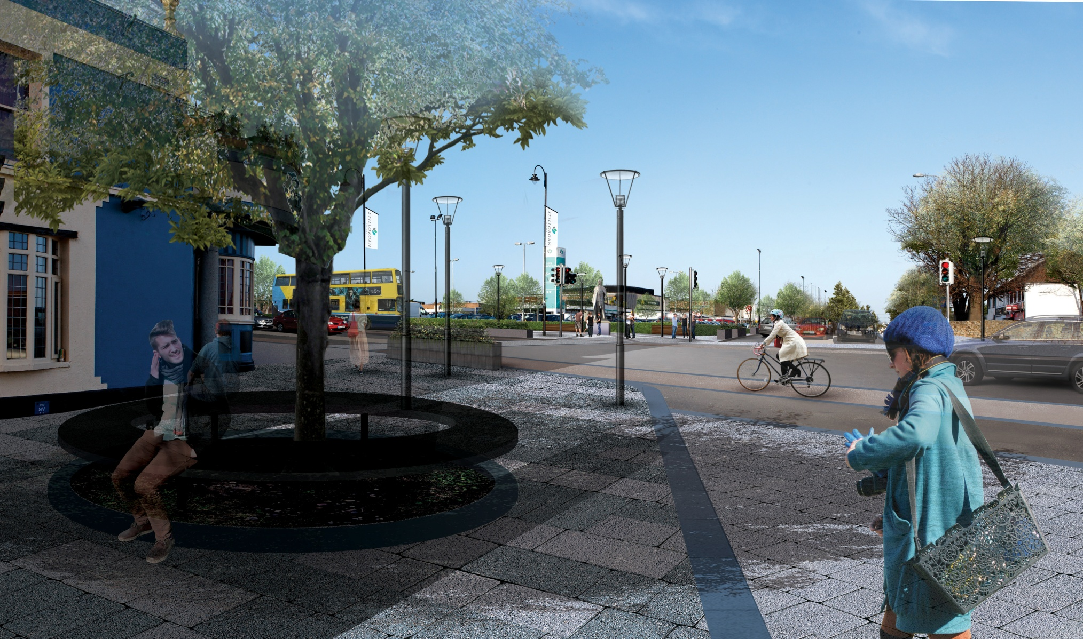
Emerging Artist’s Impression
Lower Kilmacud Rd / The Hill Junction Potential

Slide 29
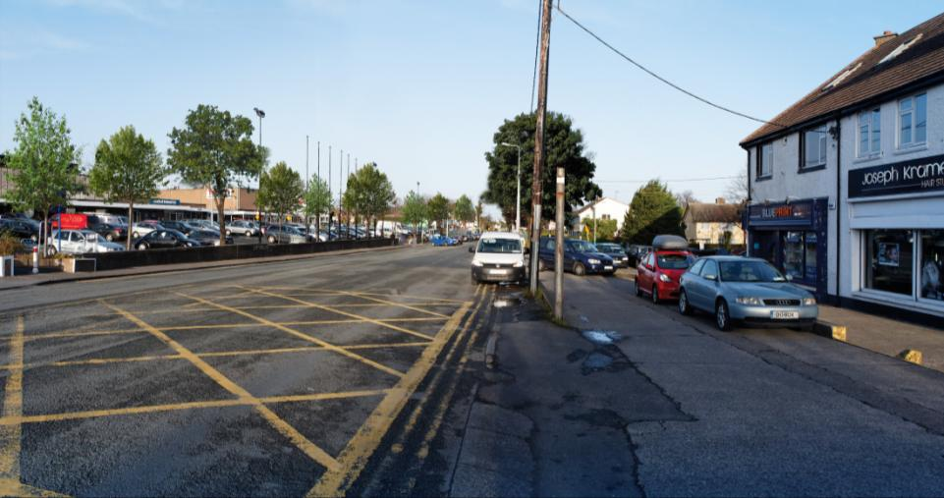
Existing Streetscape
Old Dublin Road Currently (South section)

Slide 30
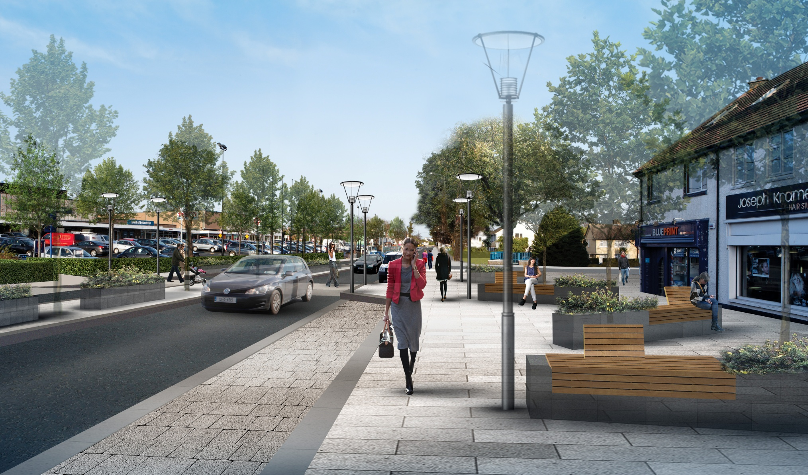
Emerging Artist’s Impression
Old Dublin Road Potential (South section)

Slide 31
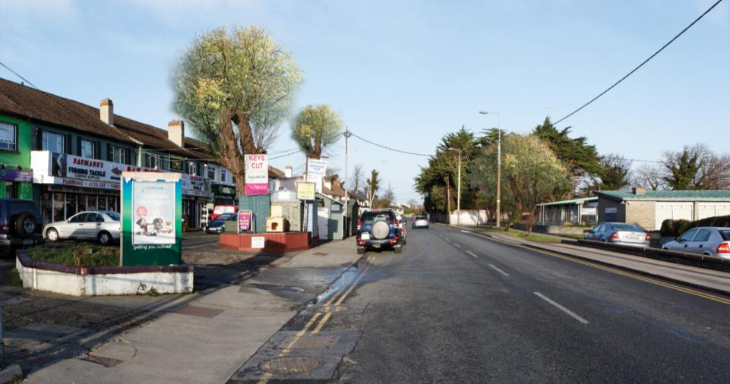
Existing Streetscape
Old Dublin Road Currently (Middle section)

Slide 32
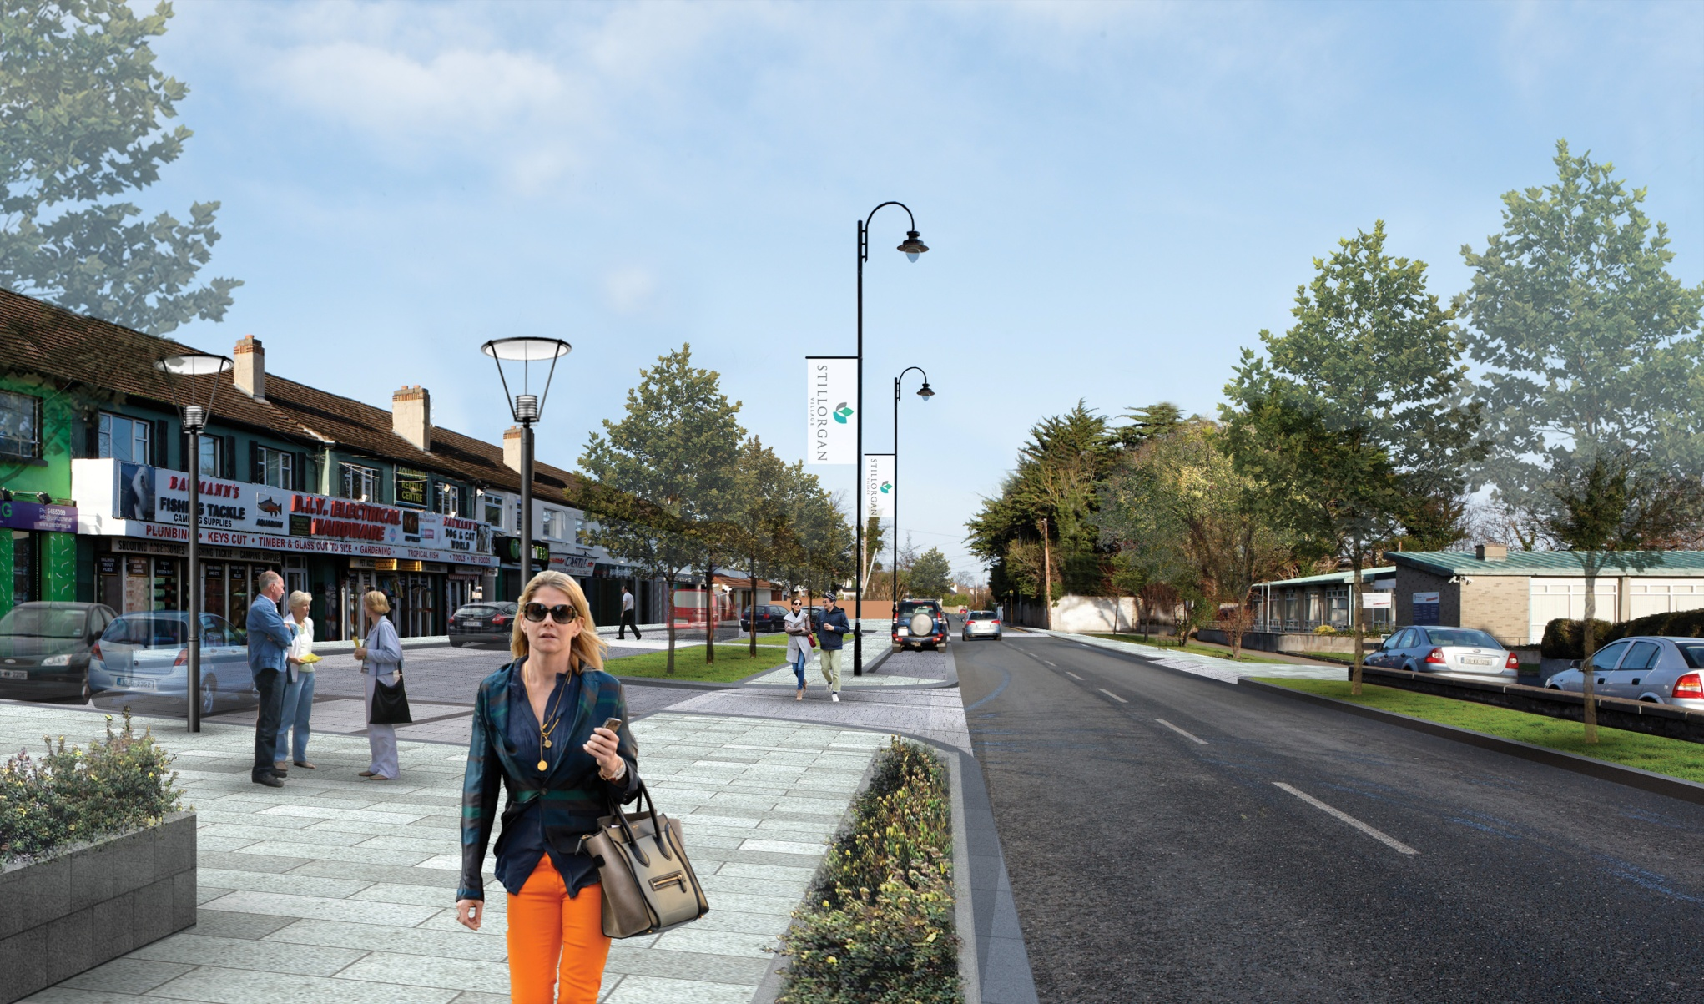
Emerging Artist’s Impression
Old Dublin Road Potential (Middle section)

